Slide 1
Indeed SEB with Java and React
Feb 12, 2024

Slide 2
Version Control with Git and Github
Learning Objectives
Define version control and identify what problems it solves for developers
Define a repository (aka repo) and identify the parts of a repo
Differentiate between a local repository and a remote repository
Synchronize a local repository with a remote repository using push and pull
Notes:
Purpose: Headline for Spring.

Slide 3
Version Control with Git and Github
Preparation
Go to your git.generalassemb.ly profile
In the top right corner, click the + and then click New Repository
Create a new repository called my_first_repository
Leave all the other inputs as their defaults
Click Create Repository
Give your instructor a thumbs up so they know you're finished
Notes:
Purpose: Headline for Spring.

Slide 4
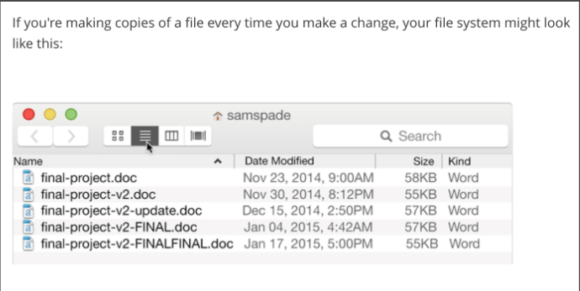
Version Control with Git and Github
Introduction
Git is a version control tool:
It keeps track of changes across a collection of files for us.
When we use Git, we can see what changes we made and seamlessly merge them with changes from our coworkers.
Notes:
Purpose: Headline for Spring.

Slide 5
Version Control with Git and Github
What is Version Control?
Simply put, version control is a way of tracking changes made to a file or group of files over time.
Git is a version control system. There are others, like Mercurial and SVN, but Git is the most popular and the most powerful.
Git will track changes made to a group of files in a directory.
Git users like ourselves can commit or save our changes and have access to a history of all the saves or commits that we have made.
Notes:
Purpose: Headline for Spring.

Slide 6
Question: 1. Why might we want to have different versions of a file? 2. What strategies have you used to keep track of changes you've made to a document or file before? If you haven't, brainstorm ways you might keep track of different versions of a file/document. 3. Did it work? Will it work in a group setting?

Slide 7
Version Control with Git and Github
Follow Up
If you've worked with track changes in Microsoft Word, then you're familiar with part of what Git does.
Track changes will track any changes (inserted text, deleted text, etc) to a document.
Git can show differences between the current version and the previous version in something called a diff (command: git diff)
Notes:
Purpose: Headline for Spring.

Slide 8
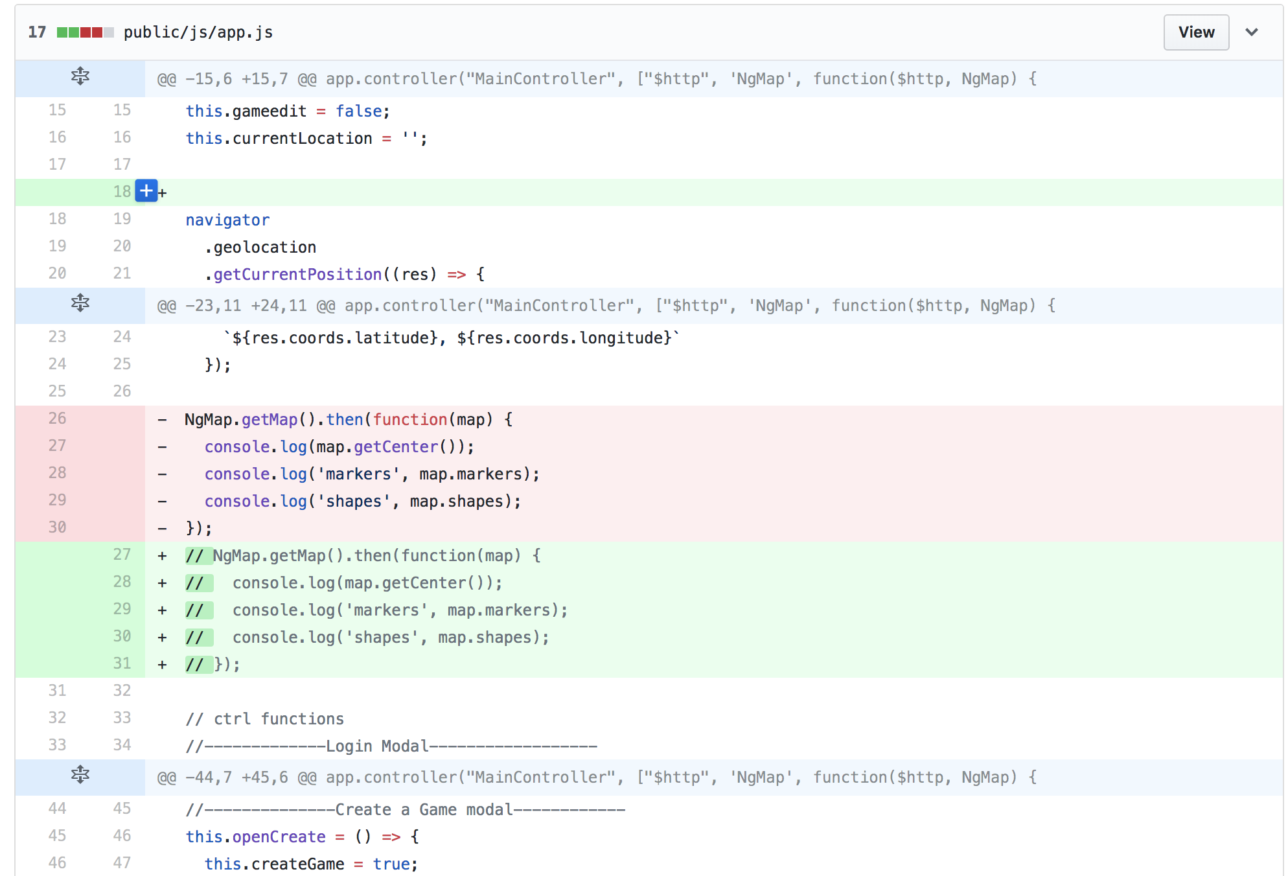
Version Control with Git and Github
Notes:
Purpose: Headline for Spring.

Slide 9
Version Control with Git and Github
How To Work with Git
Git works inside of a repository: a folder where Git is watching and tracking changes to files.
We can turn a directory into a repository by running git init
When we want to record or commit some changes we've made and 'save our progress so far, we do so by staging those changes (with git add)
and then committing them (with git commit).
If we want to see the current state of our repository, like what files have been changed and may need to be committed, we can do so by checking the repository's status (with git status).
Notes:
Purpose: Headline for Spring.

Slide 10
Version Control with Git and Github
How To Work with Git
Command | Description
git init | Initialize a repository; turn a directory into a git repo
git status | check the state of our repository
git add | stage changes to be committed
git commit | save changes to the repo's history (i.e. make them 'permanent')
Notes:
I Do: Working with Git
Watch me do the following:
Navigate to my tmp directory and create a new directory called my_first_repository
Turn this directory into a git repo with git init
Create a file in the repository called index.html
See the current state of the repository with git status
Stage the new file I created with git add
Check the new status of the repository
Commit my changes to the repository with git commit
Check the new status of the repository
Git log

Slide 11
Version Control with Git and Github
You Do: Working with Git
Now it's your turn! Work through the following steps:
Create a Day 2 directory. Inside it create a morning_classwork directory.
Inside morning_classwork create a new directory called my_first_repository
Turn this directory into a git repo.
Create a file in the repository called index.html
See the current state of the repository. What command does that?
Stage the new file you created. What was the command to do that?
Check the new status of the repository. What was the command to do that?
Commit your changes to the repository. What was the command to do that?
Check the new status of the repository. What was the command to do that?
Check the commits using git log
Notes:
Purpose: Headline for Spring.

Slide 12
Break: 10 mins

Slide 13
Version Control with Git and Github
Adding a remote SSH
- SSH stands for Secure Shell. It is a cryptographic network protocol used for operating network services securely over an unsecured network.
ssh-keygen -t rsa -b 4096 -C "your_email@example.com"
go to ~/.ssh
pbcopy < ~/.ssh/id_rsa.pub
Notes:
Purpose: Headline for Spring.

Slide 14
Version Control with Git and Github
Adding a remote
Command: git remote
When you want to manage the remote repository for a local repository, you use the git remote command.
This command has a lot of subcommands to it, including add, which we used to add our GitHub repo as the remote to our local repo:
git remote add origin <ssh_url_to_github_repo>
In the above command, origin is a name that we're giving this remote. We can call it whatever we want, but the convention is to call it origin.
Notes:
Purpose: Headline for Spring.

Slide 15
Version Control with Git and Github
Pushing Changes
Command: git push
When we have commits locally that we want to back up and "publish", we use git push.
The first time we ran this command, we may see an error
- use git push -u origin master
When we push to a remote, we want to specify:
Which remote are we pushing to (it's common to have more than one!)
Which branch are we pushing to. We will cover about branches more later in the course
Notes:
Purpose: Headline for Spring.

Slide 16
Version Control with Git and Github
How To Work with Git
Command | Description
git remote | adds a remote repository to a local repository
git push | pushes local changes to the remote repository
git pull | pulls changes from a remote repository

Slide 17

ANY QUESTIONS?

